Slide 1
On Cybersecurity
Sangram Rout, Shuheng Liao,
Yihan Ping and Ziyao Jiang

Slide 2
What is Cybersecurity
Cybersecurity refers to the practice of ensuring the integrity, confidentiality, and availability (ICA) of information. Cybersecurity is comprised of an evolving set of tools, risk management approaches, technologies, training, and best practices designed to protect networks, devices, programs, and data from attacks or unauthorized access.
Implementing effective cybersecurity measures is particularly challenging today because there are more devices than people, and attackers are becoming more innovative.
Notes:
Cybersecurity is the practice of protecting systems, networks, and programs from digital attacks. These cyberattacks are usually aimed at accessing, changing, or destroying sensitive information; extorting money from users; or interrupting normal business processes.

Slide 3
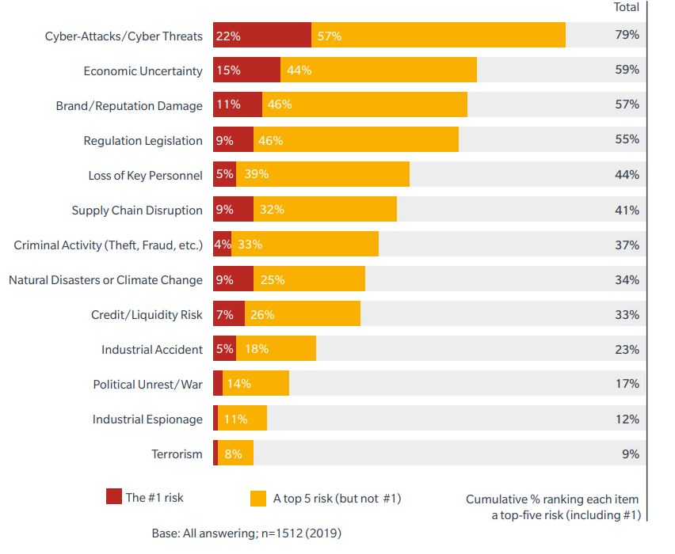
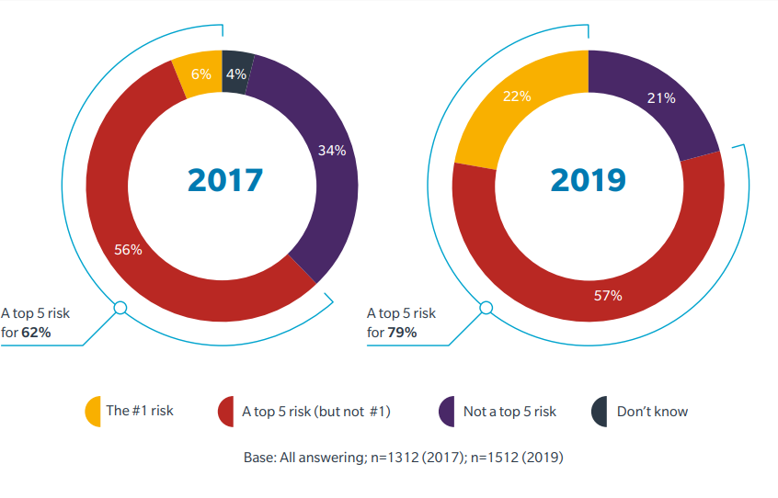
Cybersecurity in Business’s concern
Q: Of the following business threats, please rank the top 5 that are the biggest concerns to your organization
Source: Microsoft
Notes:
responders have set cyber security in a higher priority position in 2019 than 2017.
A survey by Microsoft shows that Globally, 79% of respondents ranked cyber risks as a top five concern for their organization, up from 62% in 2017. The number citing cyber risk as their #1 concern nearly quadrupled, from 6% to 22%.
In 2019, more respondents ranked cyber risk as a top concern than any other major business risk (see Figure 2). Economic uncertainty was second, ranked as a top 5 risk by 59% of organizations — a full 20 percentage points below cyber-attacks and cyber threats. These results suggest a sharp rise in the prominence of cyber risk, and correlate strongly with other recent studies. For example, the World Economic Forum (WEF) 2019 Global Risks Report ranked data theft and cyber-attacks among the top five risks most likely to occur

Slide 4
Cyber Security in Manufactuing
Internet of Things security issues could plague the manufacturing industry more than any other.
Manufacturers face a barrage of cybersecurity threats today, and half of companies have fallen victim to at least one data breach during the past 12 months, according to the 2019 Manufacturing and Distribution Report.
Notes:
One of the top ways threat actors break into manufacturers’ networks is via phishing emails and drive-by downloads. Unsuspecting employees click on links and attachments that happen to be malicious. In other cases, credentials can be stolen with no malware. Be able to spot anomalous and malicious activity as soon as it begins.

Slide 5
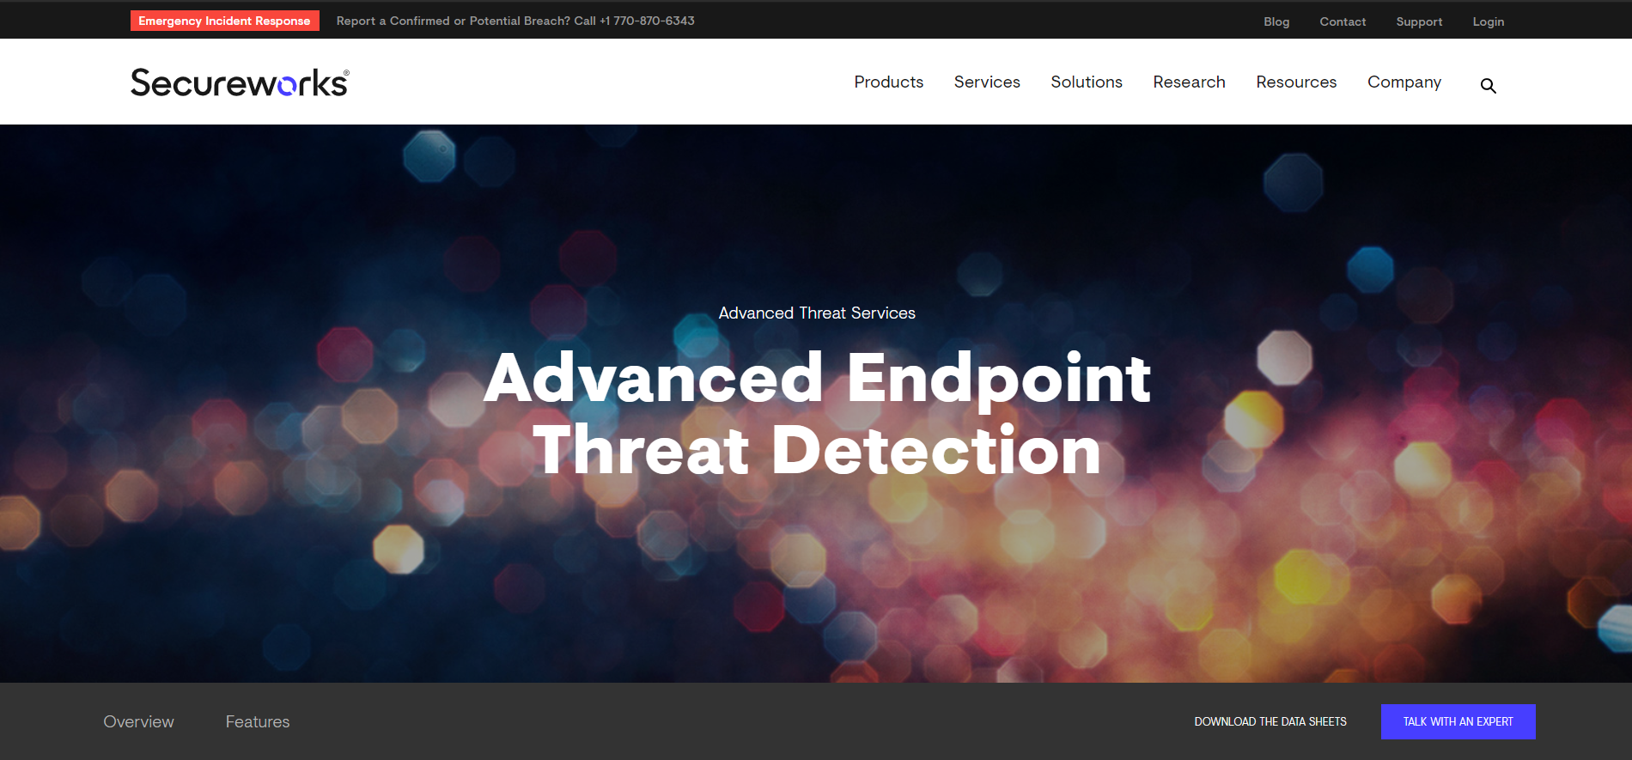
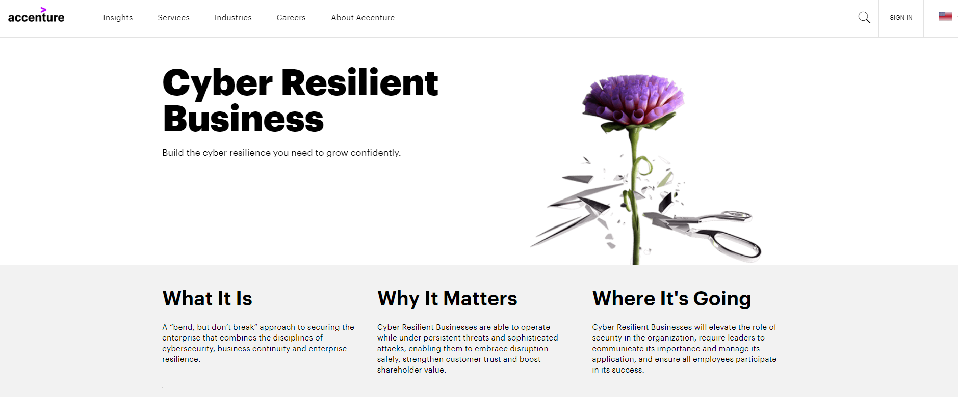


Slide 6
Trends and challenges in Cybersecurity
Cyber Confidence Declines
New technologies
Quick Changing
Lack of Recognition and Investment
“An analyst continually monitors the network, identify threats, and repairs each and any vulnerability; while the attacker only needs to find a single vulnerability that can be exploited”
-- Yurcik, Barlow & Rosendale, 2003
Source: Microsoft
Notes:
Detection of cyber risks, deal with attack and recovery for attacks
Most organizations are considering or using a range of new technologies. But, The potential benefits of new technologies are generally seen to outweigh the potential risks. Many business decision-makers are uncertain about the degree of risk posed by new business technologies.
Organizations that continuously evaluate new technology cyber risk are more confident in their overall cybersecurity.
The rate and the extent to which the cyberspace can change is extremely variable and unpredictable compared to other environments that are bound by physical constraints. The topology of the network, the services it provides, and the users who depend on these services are constantly changing. In parallel, new vulnerabilities that can be exploited continuously emerge, clever attack strategies are constantly developed and new counteracting protective measures are deployed. These challenges result in a continuous effort by the cyber security analyst to stay up-to-date on the knowledge needed to successfully defend a network.
Only 17% of executive leaders/board members spent more than a few days over the past year focusing on cyber risk issues. Confidence in cyber resilience is very low where senior leaders don’t prioritize cyber risk management.

Slide 7
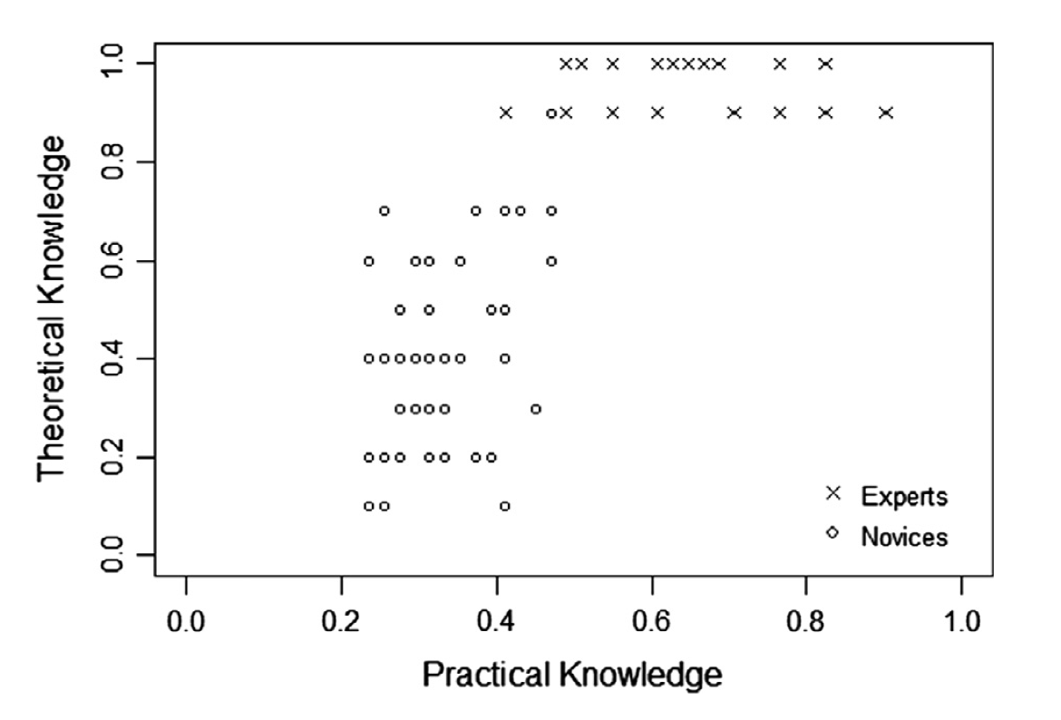
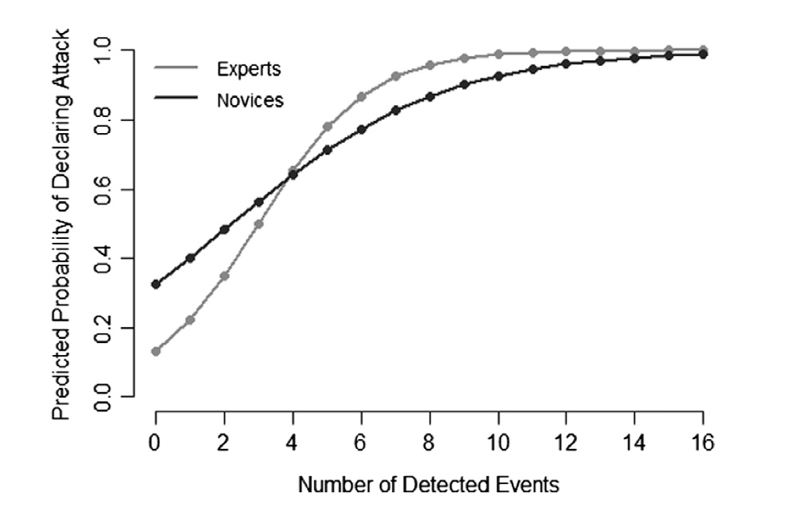
What we can do?
Notes:
Even common college students could be an expert in cyber attack detection.
There is an experiment which compared the performance of a group of experts and 55 college students in cyber attack detection. We can see the students’ practical and theoretical knowledge are both worse than experts at first, but after detected 16 events in this experiment, the students could do as well as cyber security experts.
So, as students, it’s not really difficult for us to learn get into field of attack detection.

Slide 8


Slide 9
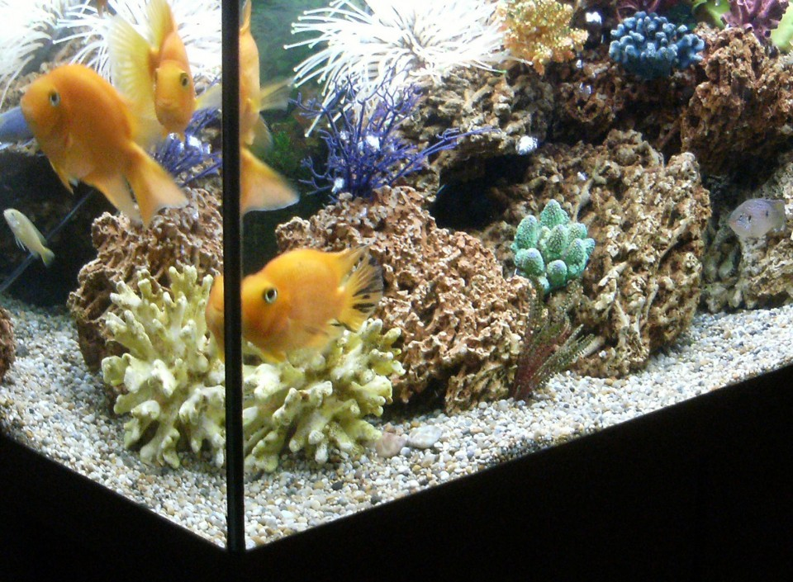

How a fish tank helped hack a casino
Notes:
https://www.washingtonpost.com/news/innovations/wp/2017/07/21/how-a-fish-tank-helped-hack-a-casino/?noredirect=on
https://interestingengineering.com/a-casinos-database-was-hacked-through-a-smart-fish-tank-thermometer

Slide 10
Overview
The hackers attempted to acquire data from a North American casino by using an Internet-connected fish tank
Temperature sensor
PC
Food sensor
Cleanliness sensor

Slide 11
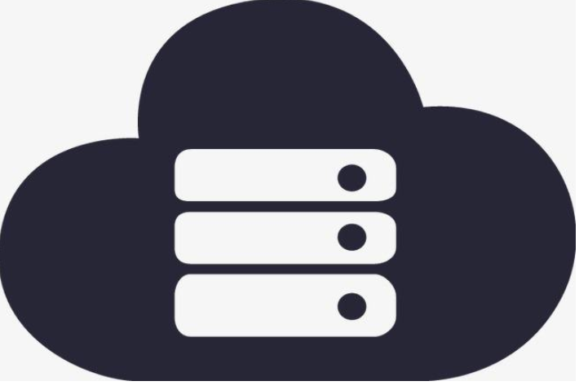
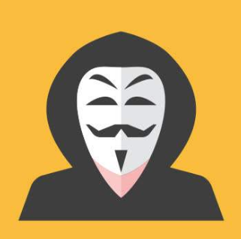


How
Get access
Vulnerability

Slide 12

Lost
10 GB of high-roller data were sent out to a device in Finland.

Slide 13
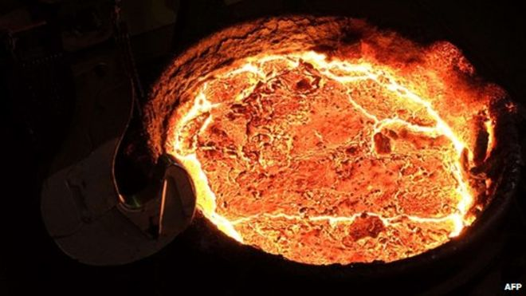

The German Steel Mill Attack
Notes:
The German Steel Mill Attack
In 2014, a cyber attack led to an explosion in a German Steel Mill, causing significant physical damage. The attack was led by hackers who utilized spear phishing to retrieve sensitive information that gave them unauthorized access to the mill’s corporate network. From there, they were able to gain access to the plant’s network where they deployed software to destroy machine interaction components. This blocked a blast furnace from initiating its security settings, thus causing an explosion with serious damage to the infrastructure of the mill — an event that was not (but easily could have been) deadly.
The German steel mill attack was particularly notable because it demonstrated that hacking groups have the capability to pivot from higher-level networks into operational networks through trusted communications channels which can be easily exploited by phishing. This poses serious threats to SIS and human-machine interfacing, both of which play large roles in IIoT.

Slide 14
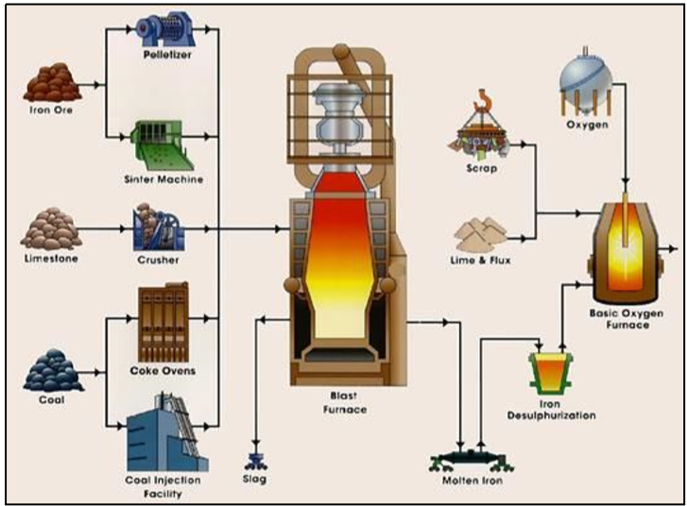
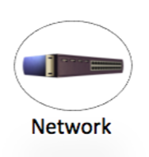
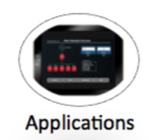

How
Mail：
Spear phishing email to gain access to the corporate network
Application：
Compromised host on corporate network
Network：moved into the plant network
Exploitation：
Demonstrated knowledge of ICS and was able to cause multiple components of the system to fail

Slide 15
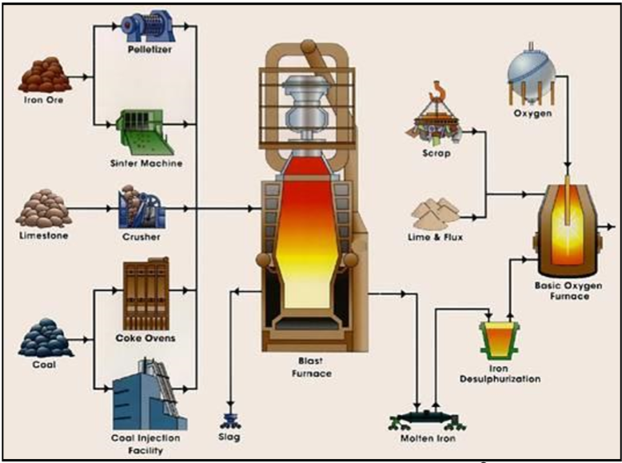
LOST
A blast furnace could not be shut down
Massive physical damage
Possible deaths and Injuries

Slide 16
Defense Lessons Learned
Technical
Architecture
Network Security Monitoring
People
Security awareness
Base knowledge
Incidence response

Slide 17

Havex
Havex is a remote access trojan (RAT) that was discovered in 2013 as part of a widespread espionage campaign targeting industrial control systems (ICS) used across numerous industries and attributed to a hacking group referred to as "Dragonfly" and "Energetic Bear".
Havex is written to infect industrial control software used in supervisory control and data acquisition (SCADA) and ICS.
Havex have the ability to disable the hydropower dams, overload the nuclear power plants, and can even turn off a country’s electrical grid with just one click.
https://www.cyber.nj.gov/threat-profiles/ics-malware-variants/havex

Slide 18
Description
Two primary components: a RAT and a C&C server written in PHP.
Includes an OPC (Open Platform Communications) scanning module used to search for industrial devices on a network.
The OPC scanning module was designed to scan for TCP devices operating on ports 44818, 105 and 502, which are are common to ICS/SCADA companies such as Siemens and Rockwell Automation. By abusing the OPC protocol, Havex mapped industrial networks once inside victim systems.
Attacking methods:
Spam Emails
Exploit kits.
“Watering-hole” attacks
https://en.wikipedia.org/wiki/Havex

Slide 19
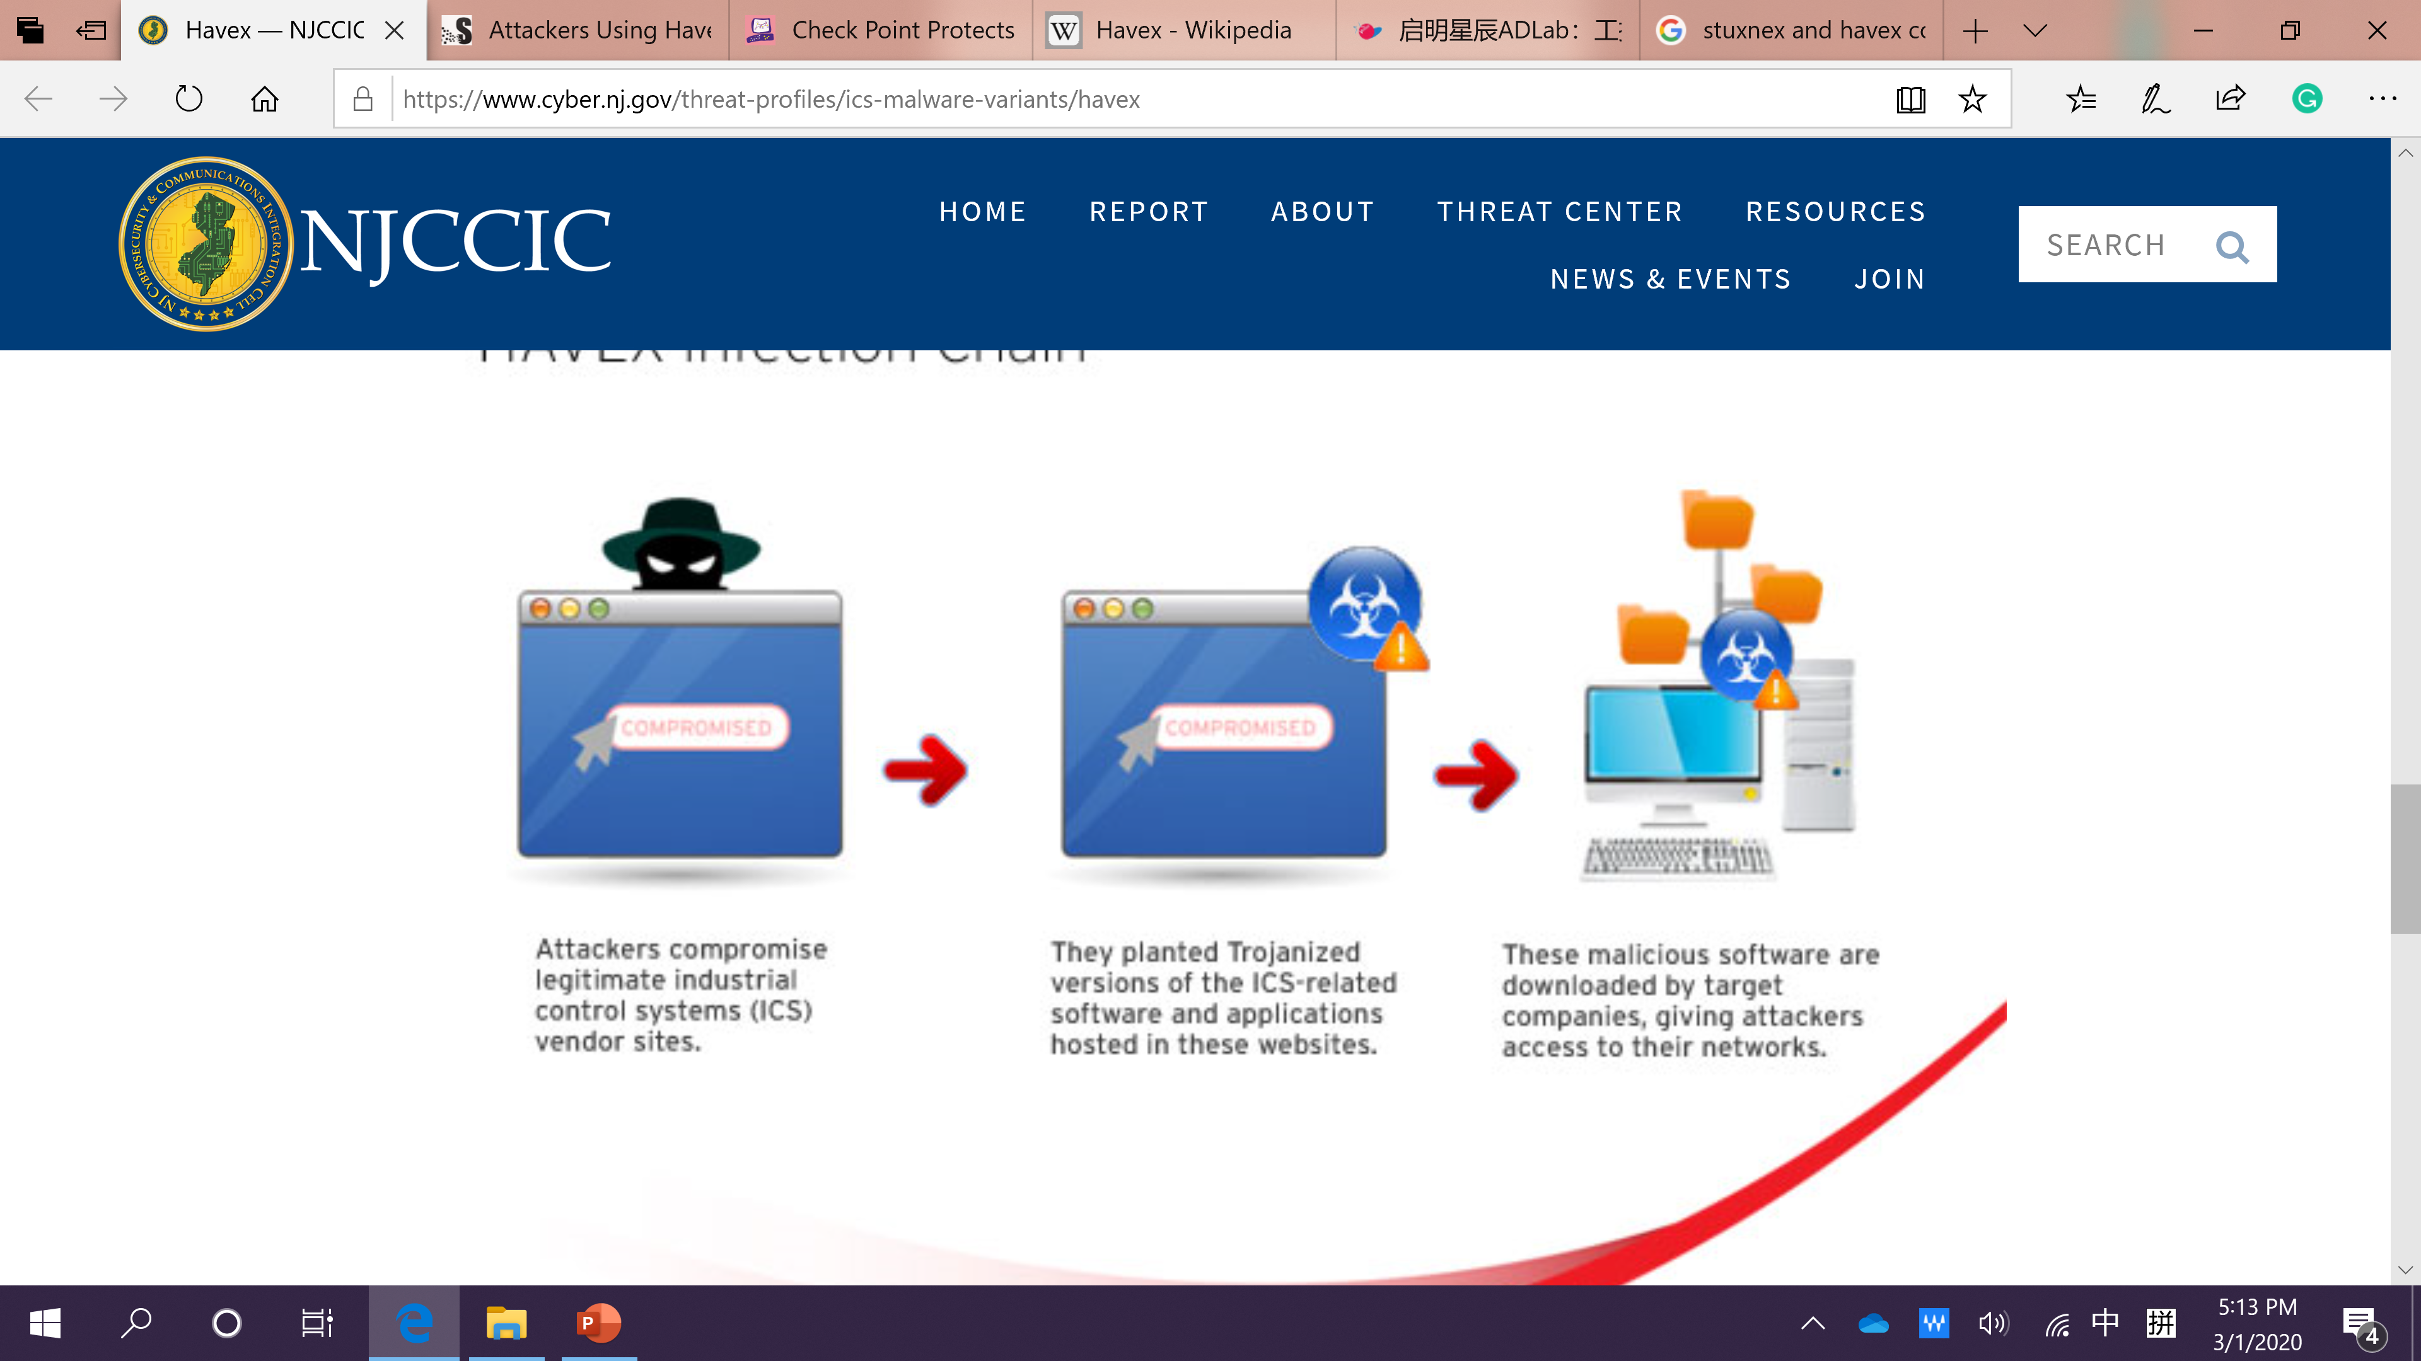
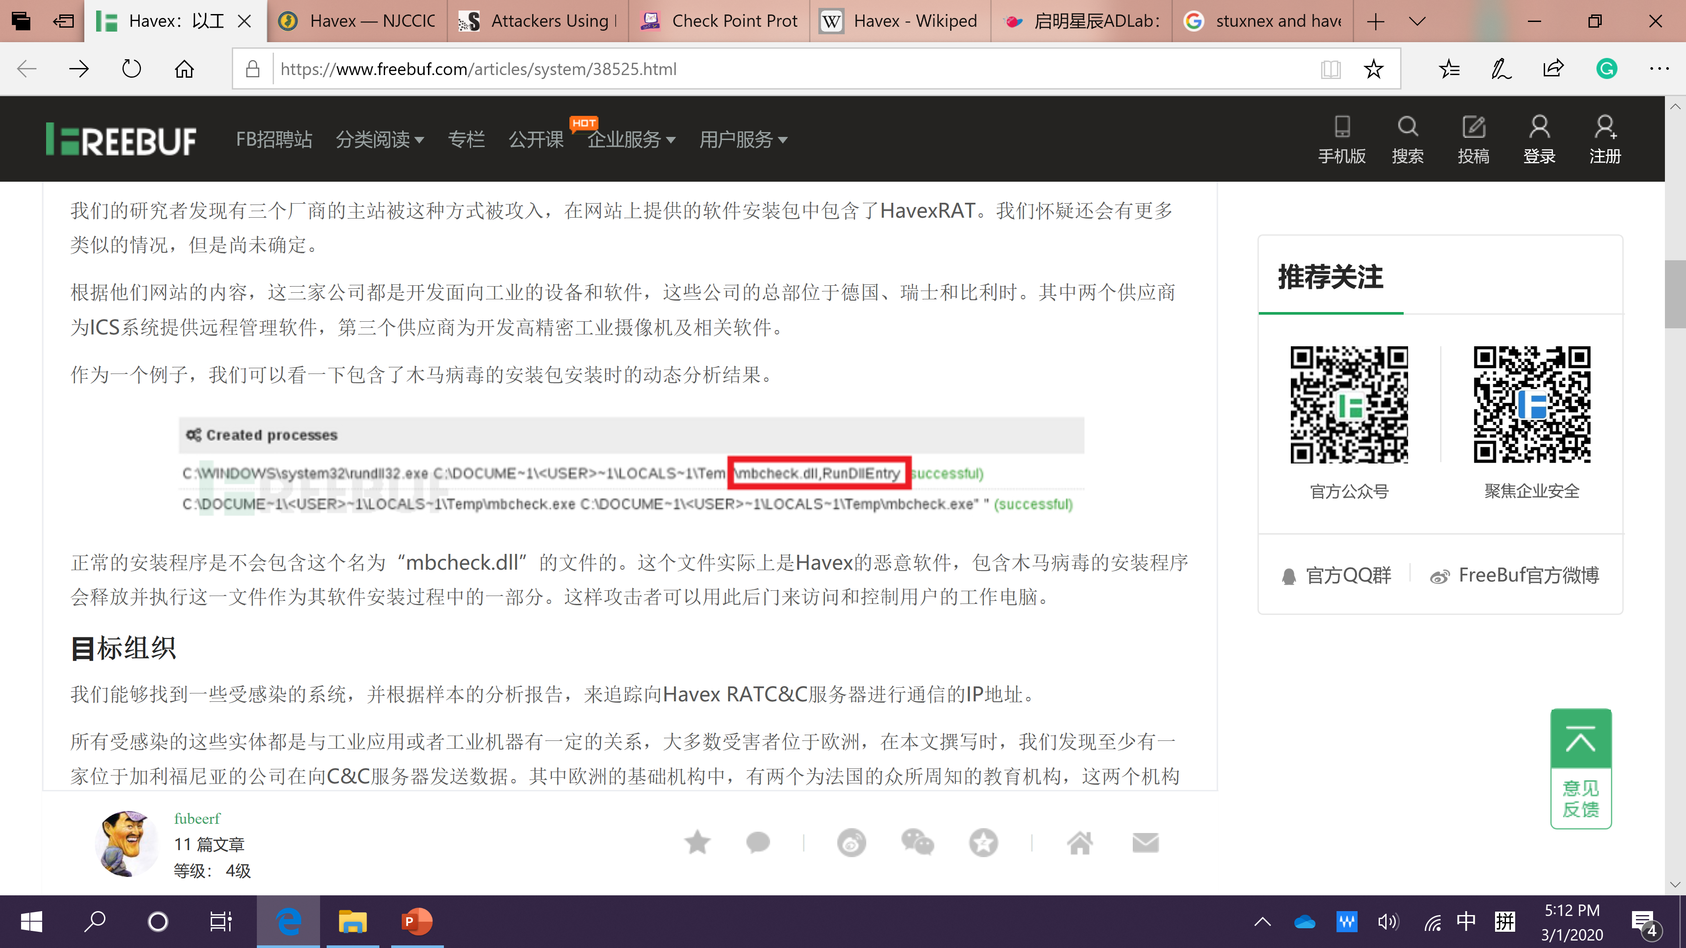
“Watering-hole” attacks
This method allows the malware to bypass traditional security measure because software was downloaded by users with authorization to install programs onto the network.
Dragonfly: Cyberespionage Attacks Against Energy Suppliers. 7 July 2014.

Slide 20
Comparison with Stuxnet
 | Havex | Stuxnet
Target | SCADA/ICS | SCADA/ICS
Goal | Data gathering | Hardware control
Propagation ways | Spam mail/Exploit kit/ “Watering-hole” attacks | USB drive
Major Affected Countries | US/Spain/Japan/France/Poland/Turkey/Greece/China/Romania/Germany | Iran/Indonesia/India/Azerbaijan/US/Pakistan

Slide 21
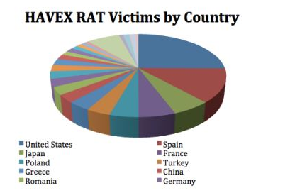
Impact
Havex malware is utilized in an espionage campaign against energy, aviation, pharmaceutical, defense, and petrochemical victims in primarily the United States and Europe.
Cybersecurity researchers estimated the campaign targeted over 2,000 sites in these regions and sectors.
Through the discovery process, researchers examined 146 C&C servers associated with the Havex campaign and 88 variants of the malware.
https://en.wikipedia.org/wiki/Havex

Slide 22
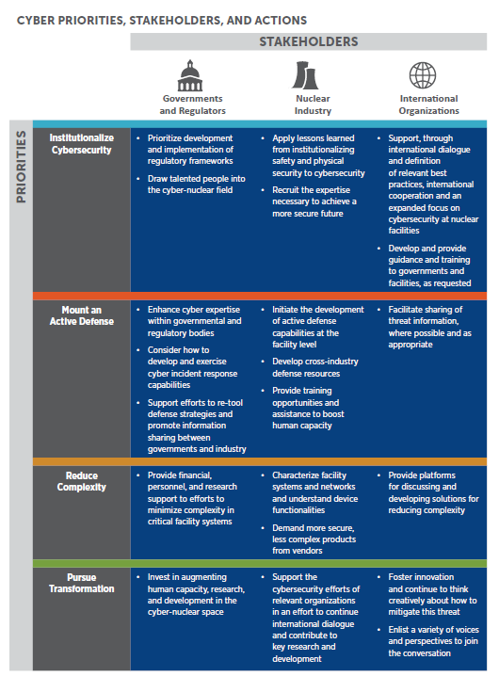
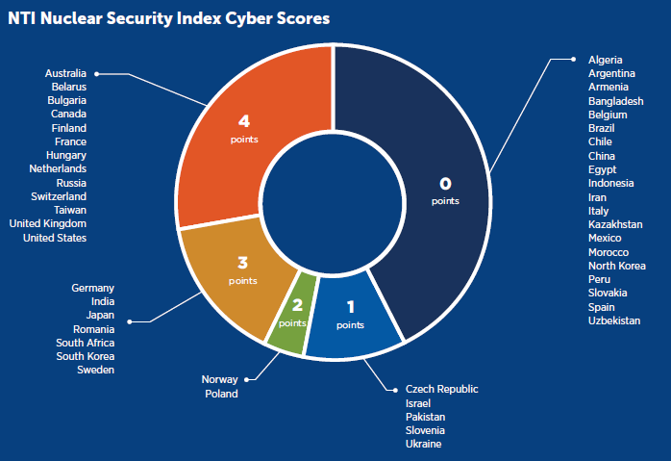
Cyberattack risk scores
31 countries
Notes:
Protocols for
8 hours reporting
31 countries

Slide 23

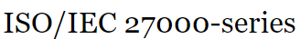


Actions to reduce cyberattack risk
Talented people into the cyber-nuclear field by investing in education and training programs and providing incentives to take jobs in this critical security sphere.
Institutionalize cybersecurity
International cooperation between organisation and exchange of best practices.
Implementation of robust processes and practices. Not a check list.
Governments should develop and implement regulatory frameworks, perhaps drawing on lessons learned from progress made in nuclear safety and physical security.
Follow other industries and stay at pace in technology.
Notes:
wide application in electronic and instrument industries
When the strip’s thickness is kept constant but the grain size is increased, the yield strength of the strip will be decreased according to the Hall-Petch effect.
Hardness was due to the pile up of dislocations at drain boundaries.
As more dislocations propagate to this boundary, dislocation 'pile up' occurs as a cluster of dislocations are unable to move past the boundary.
Decreasing grain size decreases the amount of possible pile up at the boundary, increasing the amount of applied stress necessary to move a dislocation across a grain boundary. The higher the applied stress needed to move the dislocation, the higher the yield strength.
Due to the high ratio of the free surface-to-volume of micro-parts, and the surface topography of the specimens being held constant, friction has more effect on metallic forming processes than that in traditional macro metal forming.
Role of lubricant: cooling of rolled material, reducing of rolling force, decreasing of wear of both rolls and rolled material, and lowering of friction.
An emulsion is a mixture of two or more liquids that are normally immiscible.
Rolling forces

Slide 24
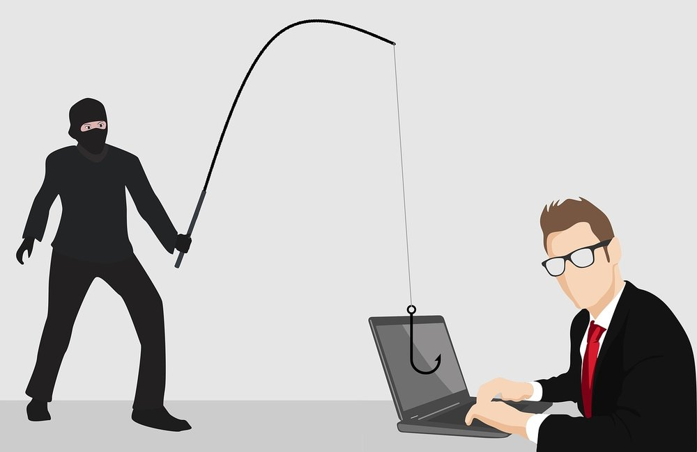
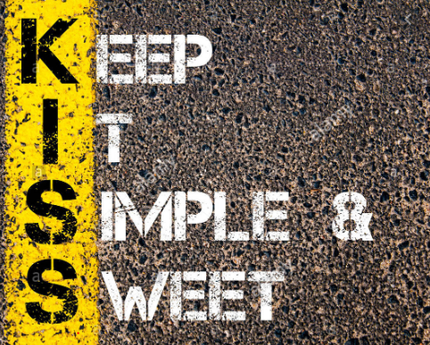
Mount an active defence system
Indicate a dynamic defence, distinct from “hacking back.”
International organizations should facilitate the sharing of threat information where possible and appropriate.
Reduce complexity
The security effects of these systems, their functionalities, and how they interact are not always fully understood.
Pursue transformation through government funding
Notes:
Other areas need focus as well
Some have defined active defenses as including of deception or honeypots, which seek to confuse attackers with traps and advanced forensics
Weird but true. Example of Juian Ottio
An attacker gains access inside the perimeter of the network and is lured into accessing one of the decoys or the deception bait.
At this point, an alert is raised and security analysts can make a choice: Shut down the attack or contain the attack within the deception environment and observe what the attacker does next through forensic analysis.
1. Control the Scope of Damage
Quarantine the known infected systems and contain the attack in an isolated environment. This is a judgment call, often driven by the depth of expertise of the security team. The analyst may decide to watch the attacker or simply shut down the attack. This option is possible because when a deception-based attack is detected, only decoy systems are at risk.
Including providing training opportunities and assistance to boost human capacity, especially in countries with new or expanding civilian nuclear energy programs.

Slide 25
Cybersecurity at top
Set the tone at the top
Assess risk
Socialize the risk profile
Remember data as asset
Drive increased awareness
“In fact, although only 25 percent of executives surveyed for the Ponemon report currently believe cybersecurity is a competitive advantage for their company.
Similarly, the percentage of executives indicating their organization's board of directors are being briefed on cybersecurity strategy is expected to grow from 22 percent today to 66 percent over the next three years”
Key findings from a recent Deloitte indicate 84 percent of executives agree there is a skills gap shortage in the US manufacturing sector including cyber risk.
Notes:
In addition, it is important to assess not only where valuable data resides in the rest of the organization, but also how its risk profile changes as it moves throughout the organization, from business systems, to the shop floor, through the supply chain, and to third parties and bac
Could be breached through a supplier
Regularly trained in a year employees

Slide 26
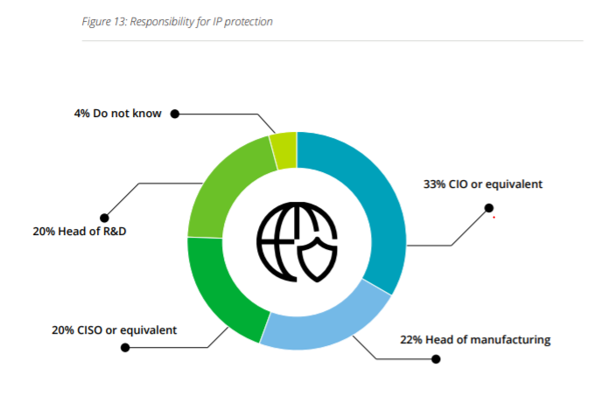
Who is responsible for Cyber security
“We were building a facility in China five years ago, and they acquired local equipment, cameras to show leadership back at headquarters live progress of construction. They put the live feed on the Internet, but did not realize this rendered it/us as a target. It was hacked. It was brutal.”
Chief Information officer
Chief information
security officer

Slide 27
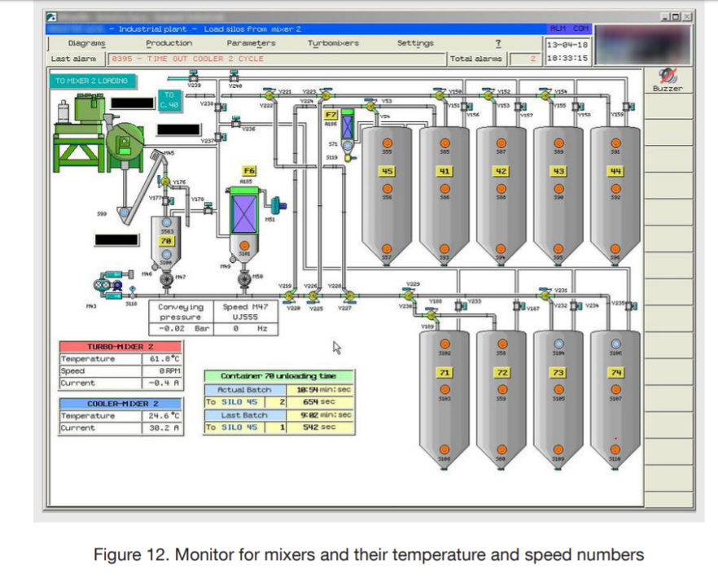
Examples of manufacturing machines we found using the IoT search engine Shodan
https://cybersecurityventures.com/cybersecurity-almanac-2019/
Insulin pumps
https://www.mckinsey.com/~/media/McKinsey/McKinsey%20Solutions/Cyber%20Solutions/Perspectives%20on%20transforming%20cybersecurity/Transforming%20cybersecurity_March2019.ashx

Slide 28
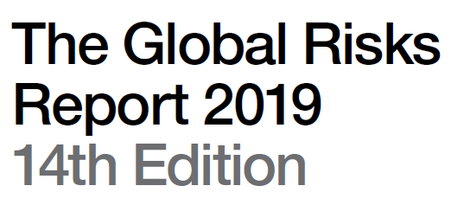
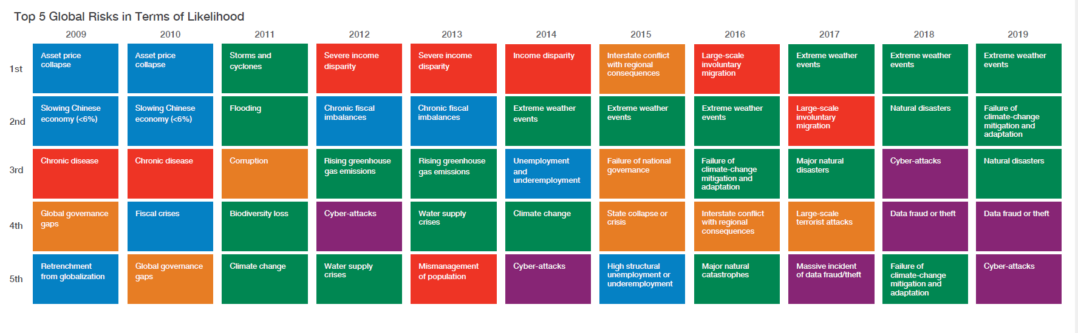
Top 5 Global Risks in terms of Likelihood

Slide 29
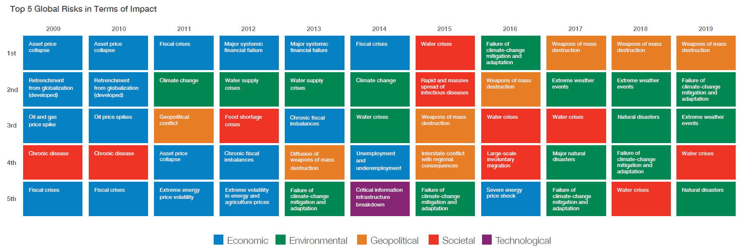
Top 5 Global Risks in Terms of Impact

Slide 30
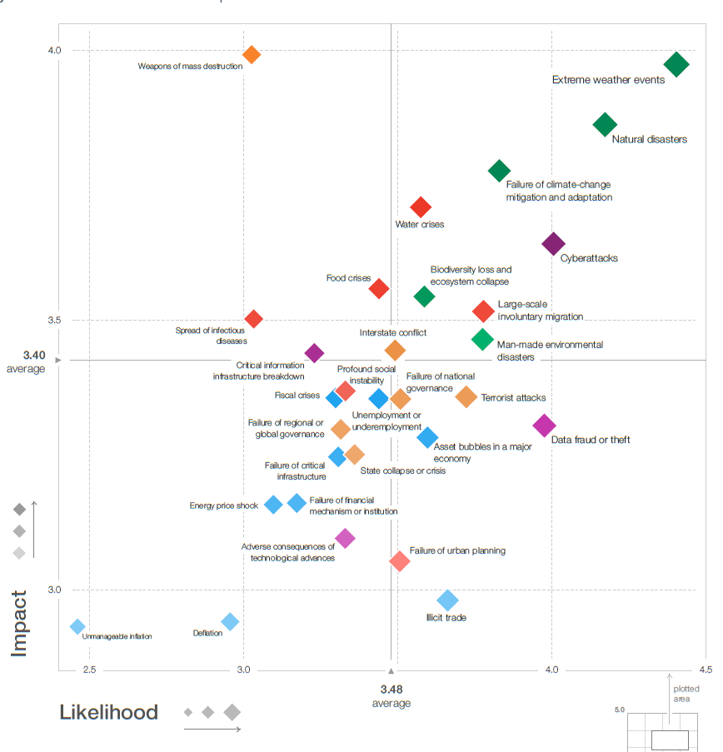
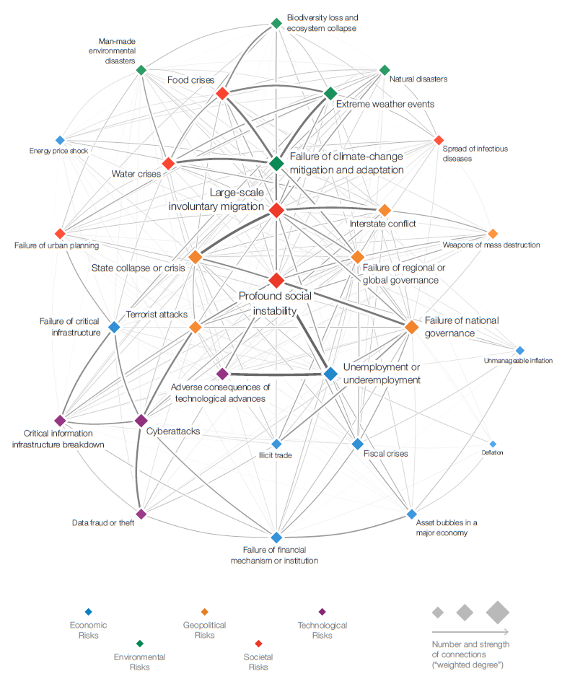
The Global Risks Report

Slide 31


Thank You
Questions?

